Slide 1
Headless Adobe Experience Manager – Beyond the Browser
Bryan Stopp | Technical Architect – Delivery Excellence

Slide 2
1 | Welcome and Overview
2 | Experience Fragments
3 | Content Fragment Models & Instances
4 | Component Exporter (Advanced)

Slide 3
Adobe User Experience Design Engagement
Some members Adobe’s User Experience Design group will be joining us today.
They are here to learn by observing your experiences.
While you should bring specific questions to your designated TAs, the Adobe Design TAs will be happy to hear any critiques, pain points, or suggestions on user experience you may like to share.
They can be identified by the gray Community Engagement t-shirts.

Slide 4
1 | Welcome and Overview
2 | Experience Fragments
3 | Content Fragment Models & Instances
4 | Component Exporter (Advanced)

Slide 5
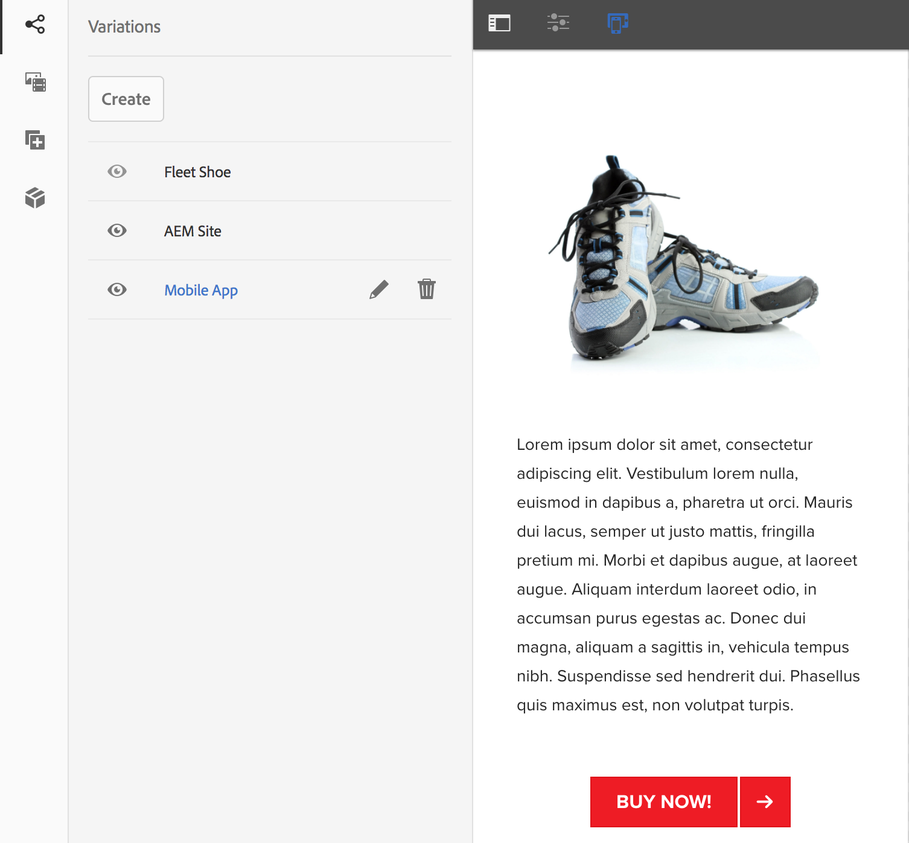
Experience Fragments (XF) - Activities
Create Experience Fragment
Create a Building Block
Create Variations
AEM Sites
Mobile App
Consume an XF
Update XF

Slide 6
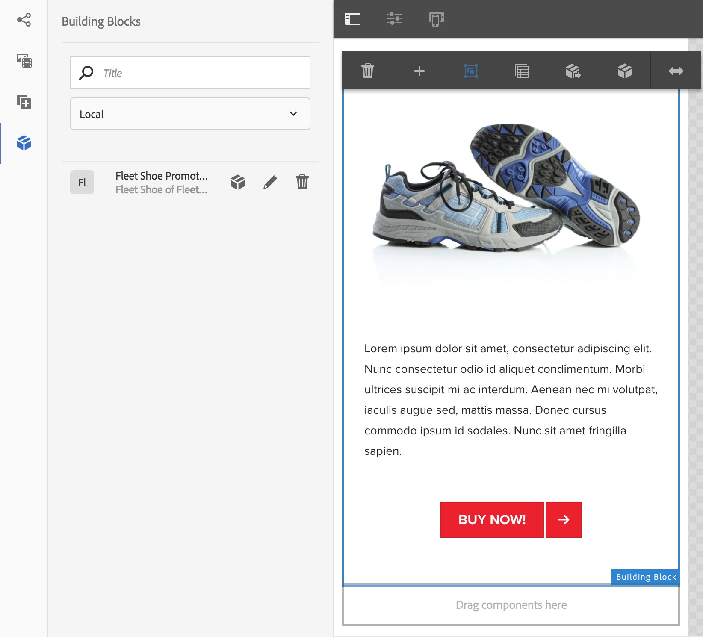
Experience Fragments - Building Blocks
Specifies reusable structure and content
Automatic updates of referencing XF
Usable across XF (Local vs All)
Best Practices:
One XF Variation holds building block
All other XF consume building block
Inheritance can be canceled
Removes back-reference for updates
Cannot be undone

Slide 7
Experience Fragments (XF) - Activities
Create Experience Fragment
Create a Building Block
Create Variations
Desktop
Mobile
Consume an XF
Update XF

Slide 8
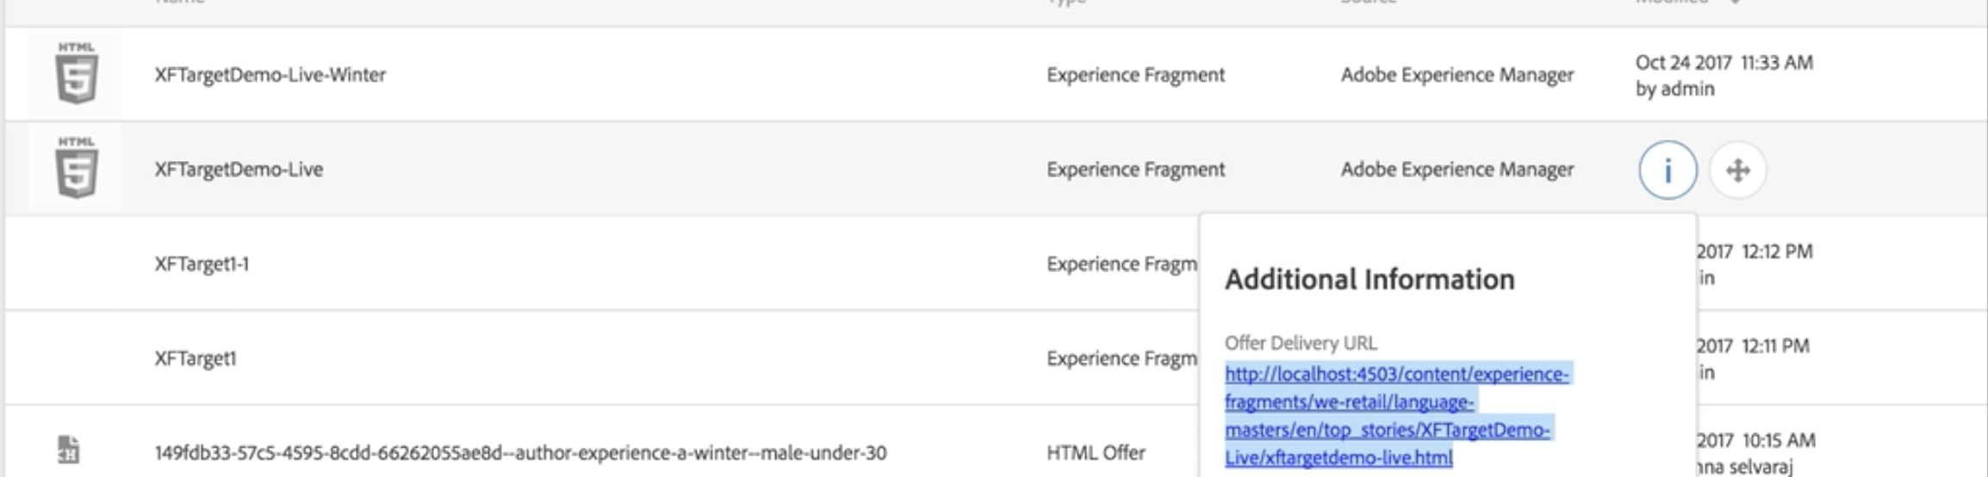
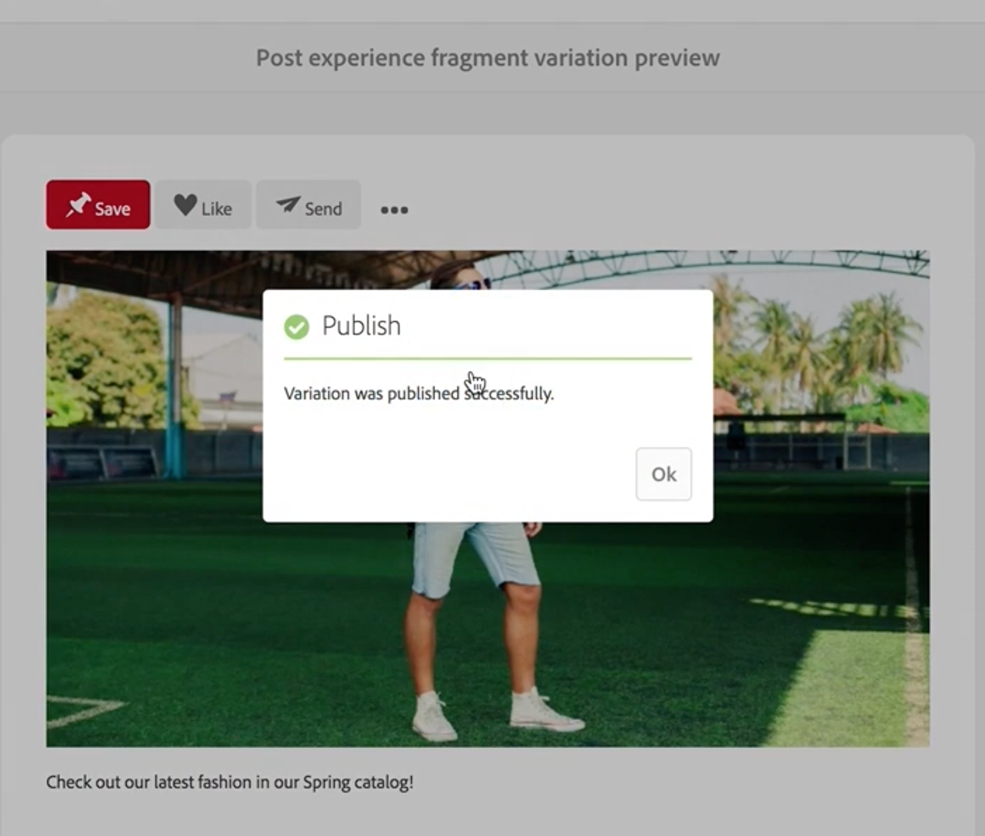
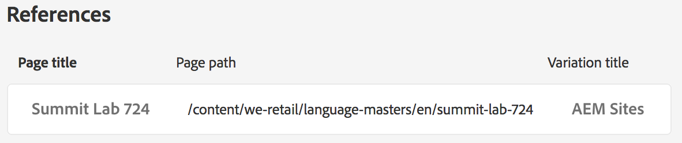
Experience Fragments - Extra Info
Beta – Publish To Target
Displayed via reference
Social Posting
Publishes XF to Social platform
Cloud Config. Req.
Content in XF is not “on page” when consumed directly
Displayed via reference
JCR based searches will return 0 results
Crawlers will still function as expected
Referenced pages available on XF Properties
Notes:
Every varation in

Slide 9
1 | Welcome and Overview
2 | Experience Fragments
3 | Content Fragment Models & Instances
4 | Component Exporter (Advanced)

Slide 10
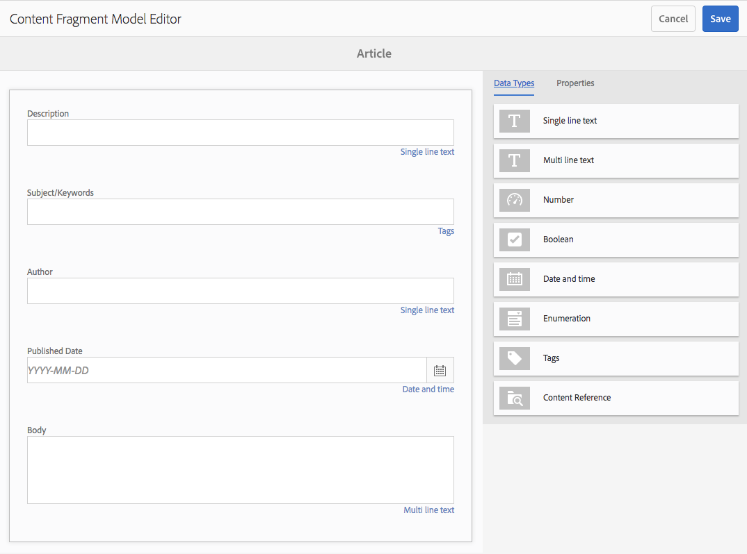
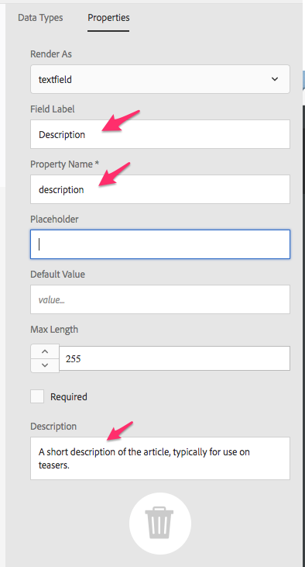
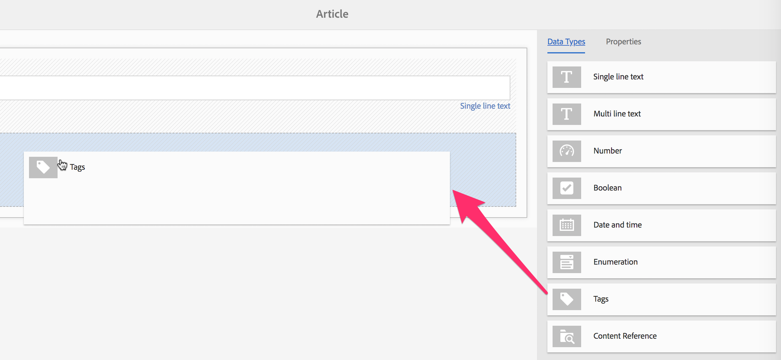
Content Fragment – Model Activities
Enabling Content Fragments
Assets Folder Configuration
Define Model Structure

Slide 11
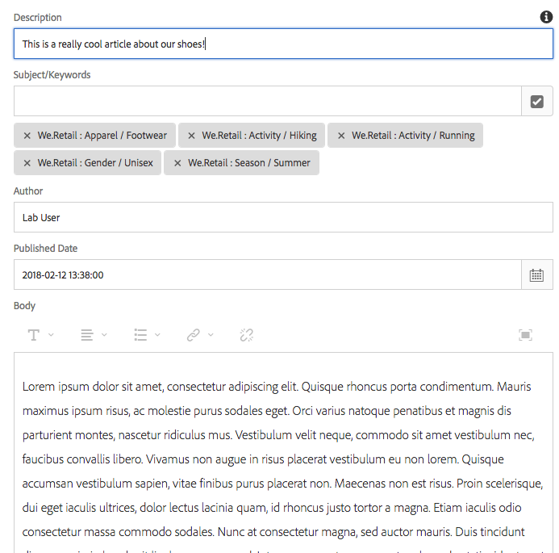
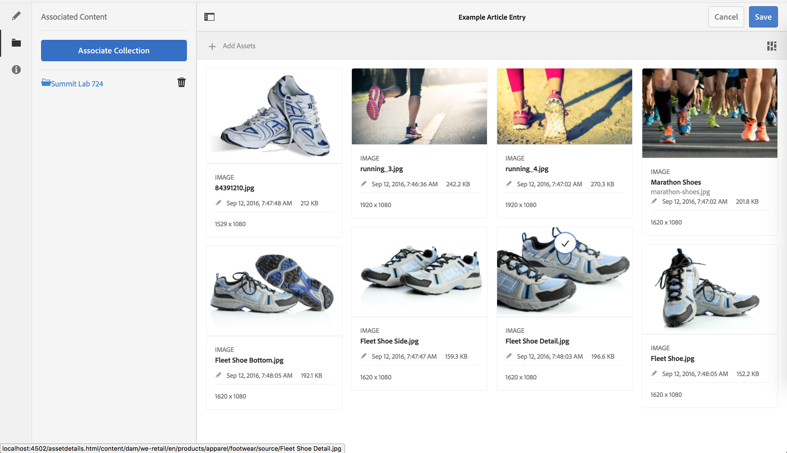
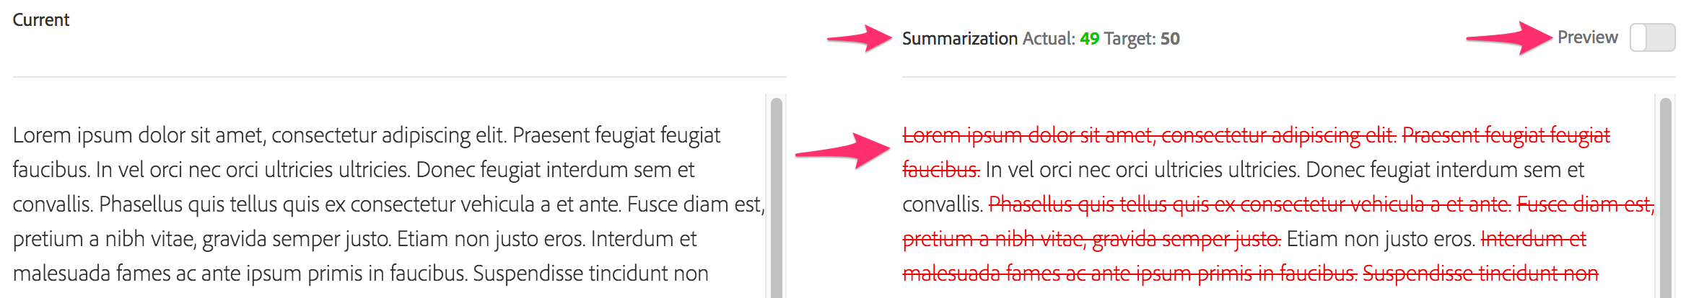
Content Fragment – Instance Activities
Create Content Fragment
Summarize
Associated Content

Slide 12
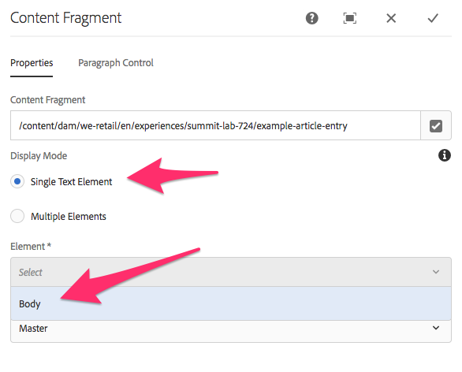
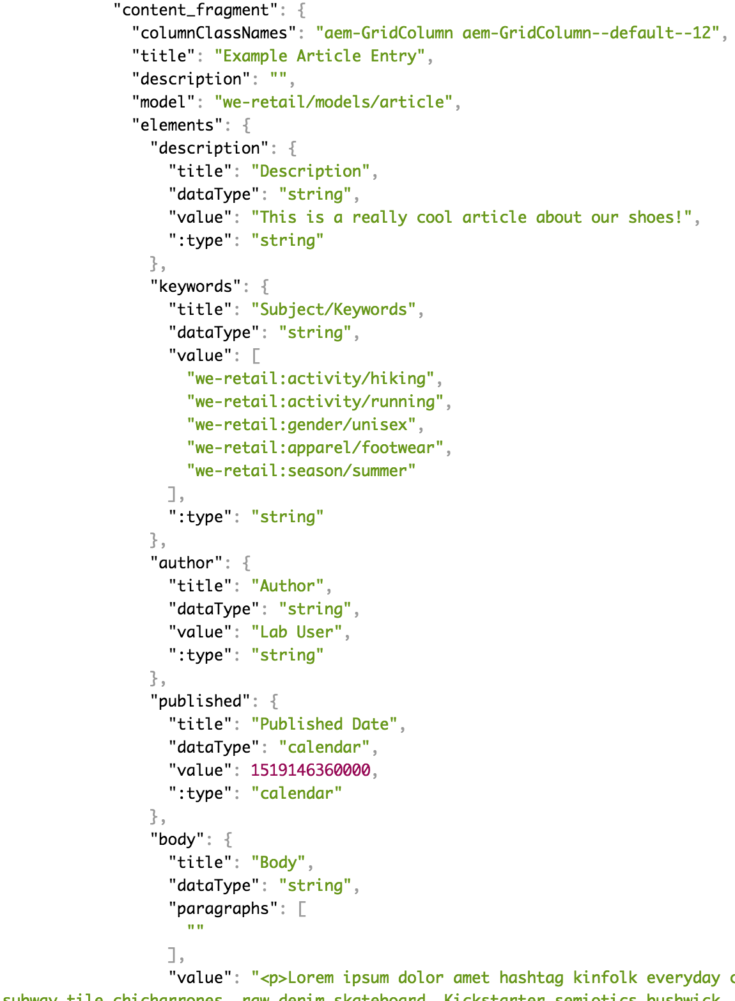
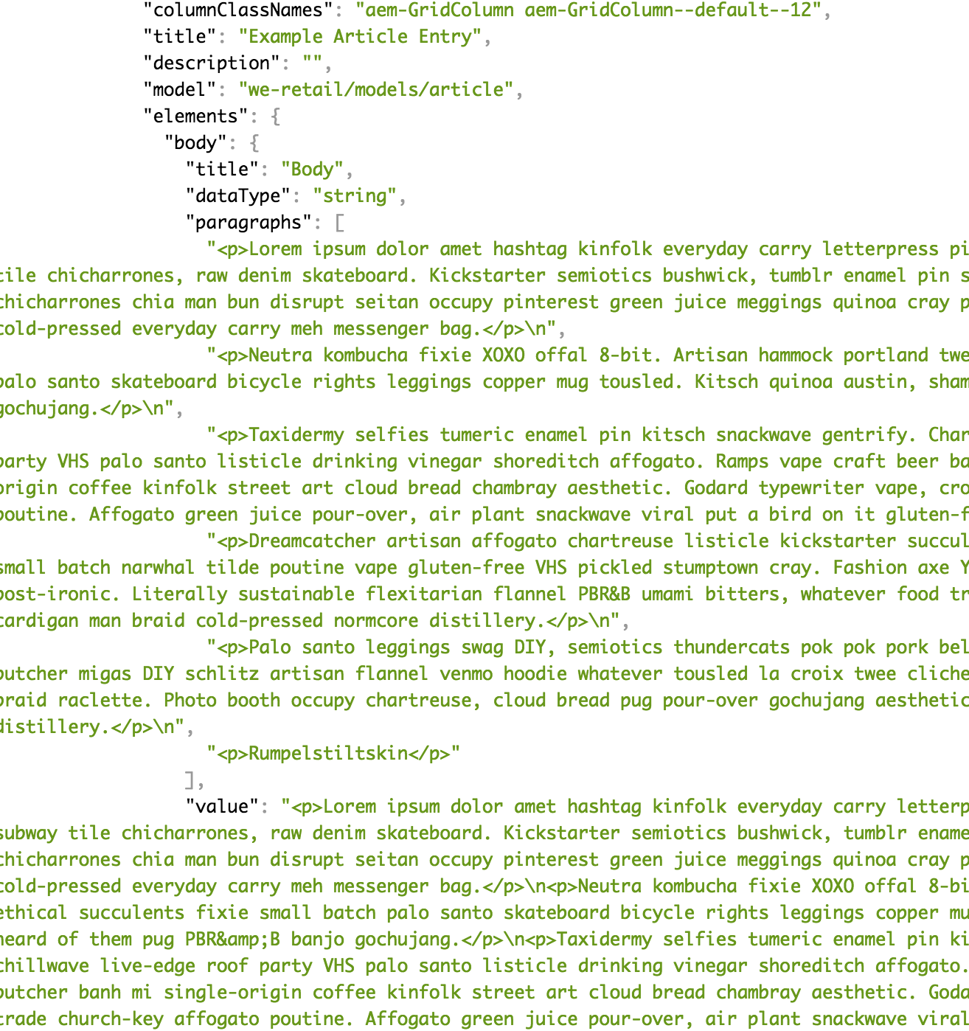
Content Fragment – Authoring Activities
HTML Page
Associated Content
Service API Page

Slide 13
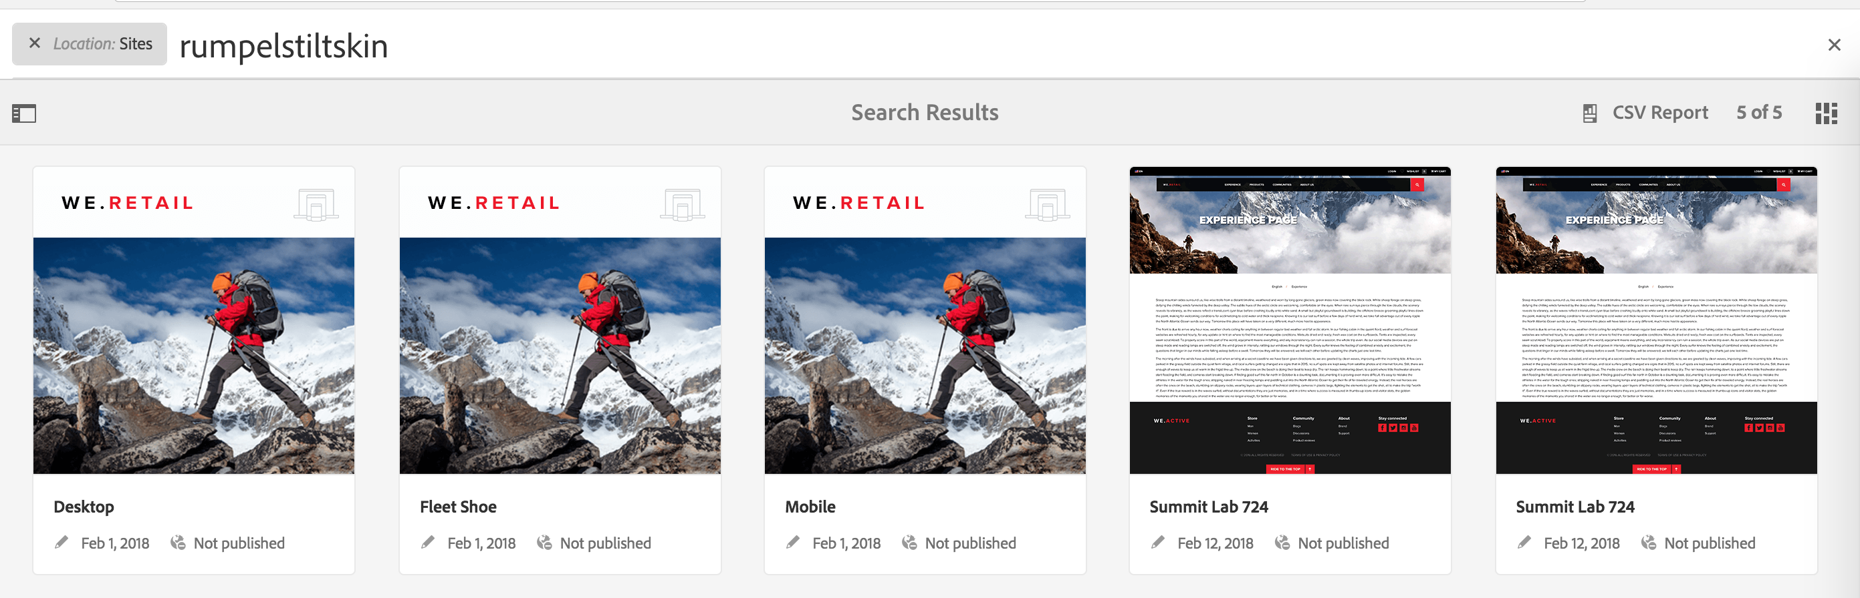
Content Fragments - Extra Info
No search limitations like XF
Content is copied to target Content Fragment component
Relationship managed via Multi-Site Manager library
Not visible in MSM dashboard.

Slide 14
Experience Fragments vs. Content Fragments
Experience Fragments
Group of components with layout that can live independently
Experiences for reuse.
Consumed as whole “thing”
Purpose
Cross Channel
3rd Party Consumption (Target)
Getting Technical
Page - cq:Page node structure
Content Fragments
Editorial / Semantic Copy
Logical grouping of data
Consumption based on use case
As much or as little as desired
Purpose
Site rendering
API/JSON
Getting Technical
Assets - dam:Asset node structure

Slide 15
1 | Welcome and Overview
2 | Experience Fragments
3 | Content Fragment Models & Instances
4 | Component Exporter (Advanced)

Slide 16
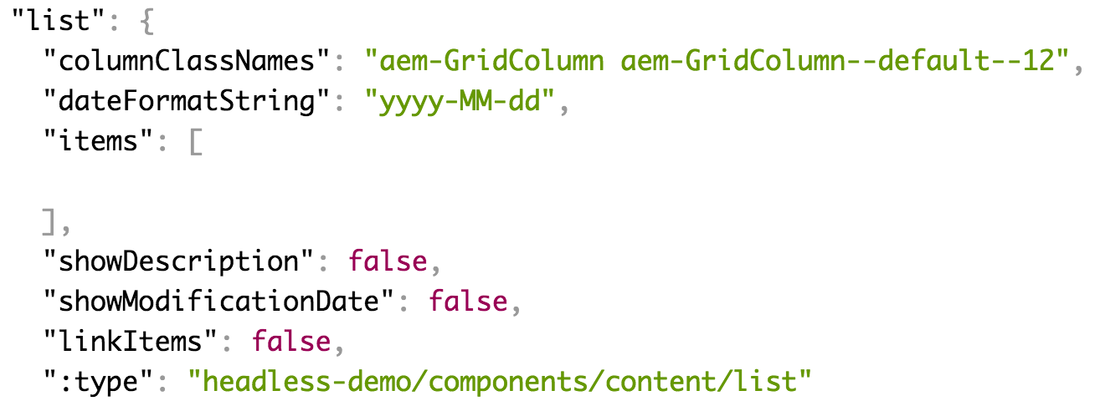
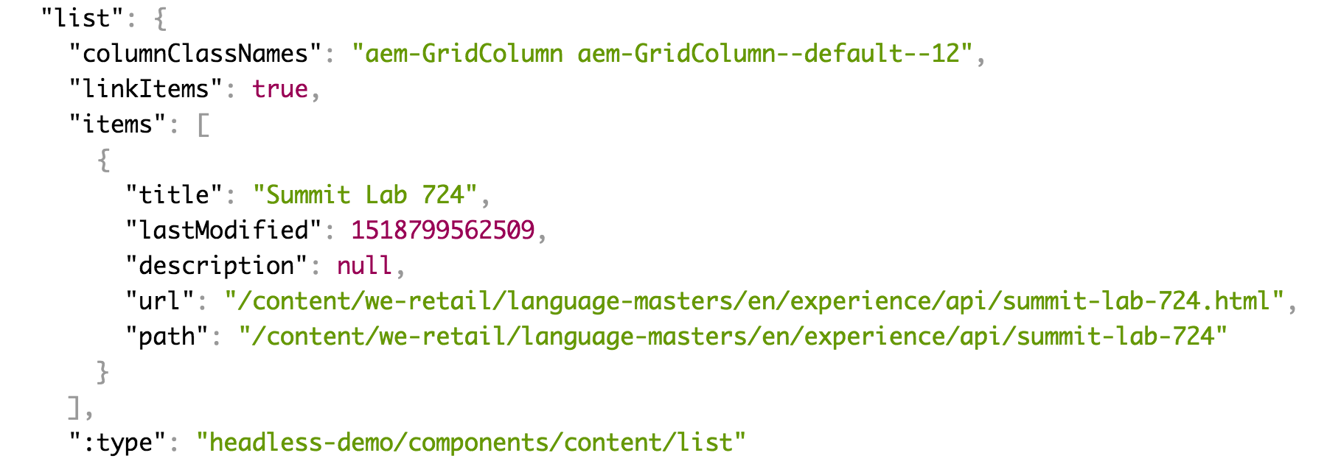
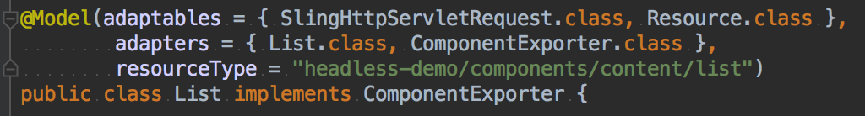
Component Exporter - Advanced Topics
Existing JSON Output
Component Model Update
Updated JSON

Slide 17
Bryan Stopp
stopp@adobe.com
Twitter: @StoppThinking

Slide 18
Summit 2018 GitHub Repo
https://github.com/Adobe-Marketing-Cloud/Summit2018
Branch L724

Slide 19




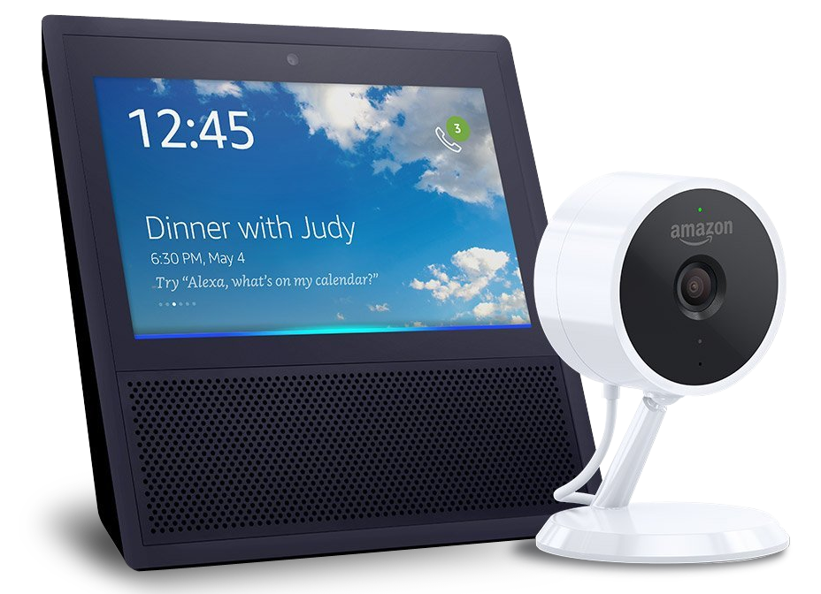
Take the Survey to win!
(Survey section of the mobile app)
SESSION PRIZE
one per session
$10
Starbucks
Card
DAY 1
DAY 2
DAY 3
Bash Experience
Signed football helmet
Amazon Echo Show & Cloud Cam Bundle

Slide 20


JOIN US IN THE COMMUNITY PAVILION
Get your SUMMIT SELFie!. Share with friends, earn badges, and win prizes.
Talk with our
Experience Experts from Services & Learning.
See live speaker sessions at the Experience Theater.
Notes:
EP to present

